Slide 1
Group 5: Predictive Modeling for Wildfire Risk
BUAN: 6341.003, Applied Machine Learning
Esha Pandey
Hitarth Jagdish Parmer
Pramit Shivakumar Jagate
Yashaswi Ramachandra Reddy

Slide 2
Table of Content
1.
2.
3.
4.
5.
Introduction
Data Description
Exploratory Data Analysis
Data Modeling
Results

Slide 3



Introduction
Predicting Wildfire Risk Using Machine Learning and Environmental Data
Preface
Wildfires in California are rising in frequency and intensity due to climate change, drought, and vegetation stress. Early detection of high-risk zones is key to better resource allocation and disaster response.
Objective
Predict wildfire risk across California by analyzing environmental patterns
Approach
Integrate wildfire and environmental data
Train and evaluated Regression models
Generated calibrated fire risk predictions

Slide 4
Data Description
Data Sources:
NASA FIRMS : Provides satellite-detected wildfire occurrences and fire intensity data
NOAA Climate Data: Contains climate variables such as temperature, humidity, wind speed, and precipitation, which influence wildfire risk
Column Name | Description
latitude | Latitude of fire event
longitude | Longitude of fire event
acq_date | Acquisition date of fire
satellite | Satellite source
instrument | Instrument used to record the fire
confidence | Fire detection confidence score
year | Year of the event
month | Month of the event
year_month | Merging key (YYYYMM)
PRECTOTCORR | Avg. daily precipitation (mm)
PRECTOTCORR_SUM | Total monthly precipitation (mm)
RH2M | Relative humidity (%)
WD10M | Wind direction (degrees)
WS10M_RANGE | Wind speed range (m/s)
NDVI | Vegetation index (0 to 1)
T2M | Avg. temperature at 2m (Celsius)
T2M_MAX | Max temperature (Celsius)
TS | Surface (skin) temperature
elevation | Avg. elevation (m)
slope | Avg. terrain slope (degrees)
aspect | Avg. terrain aspect (degrees from North)
latitude
Longitude
Year_month
Confidence
RH2M
aspect
T2M
slope
WD10M
Elevation
NDVI
PRECTOTCORR
T2M_MAX
Final Data frame

Slide 5
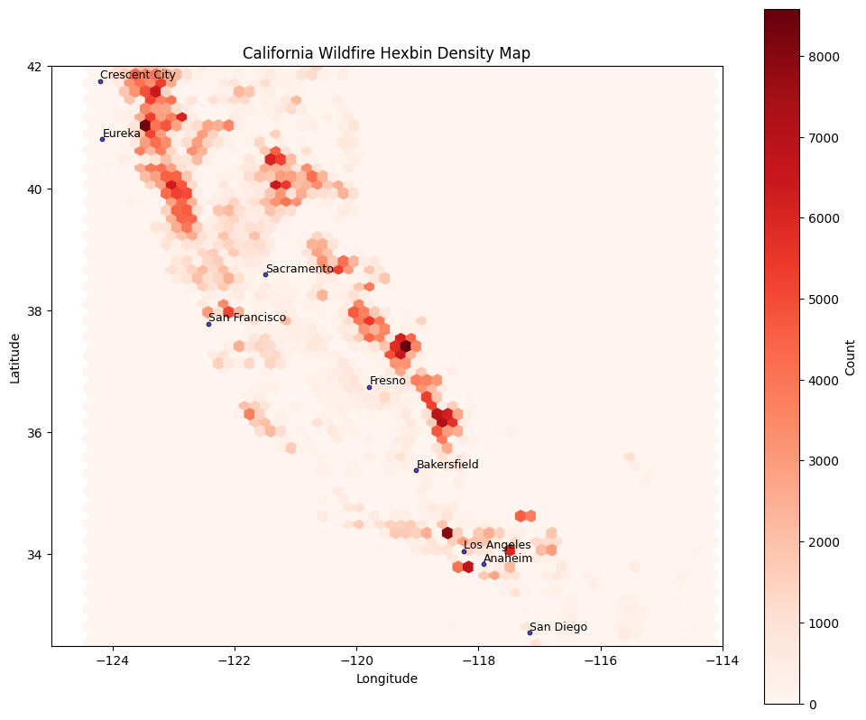
Exploratory Data Analysis
Most wildfires occur due to low vegetation, low humidity and high temperatures
Majority of fires occurred in national forest regions
In 2020, wildfires were at their peak, with a total of 270,710 reported incidents — the highest on record
Hotspots Identified in :
Northern California
Central-Eastern California
Southern California

Slide 6
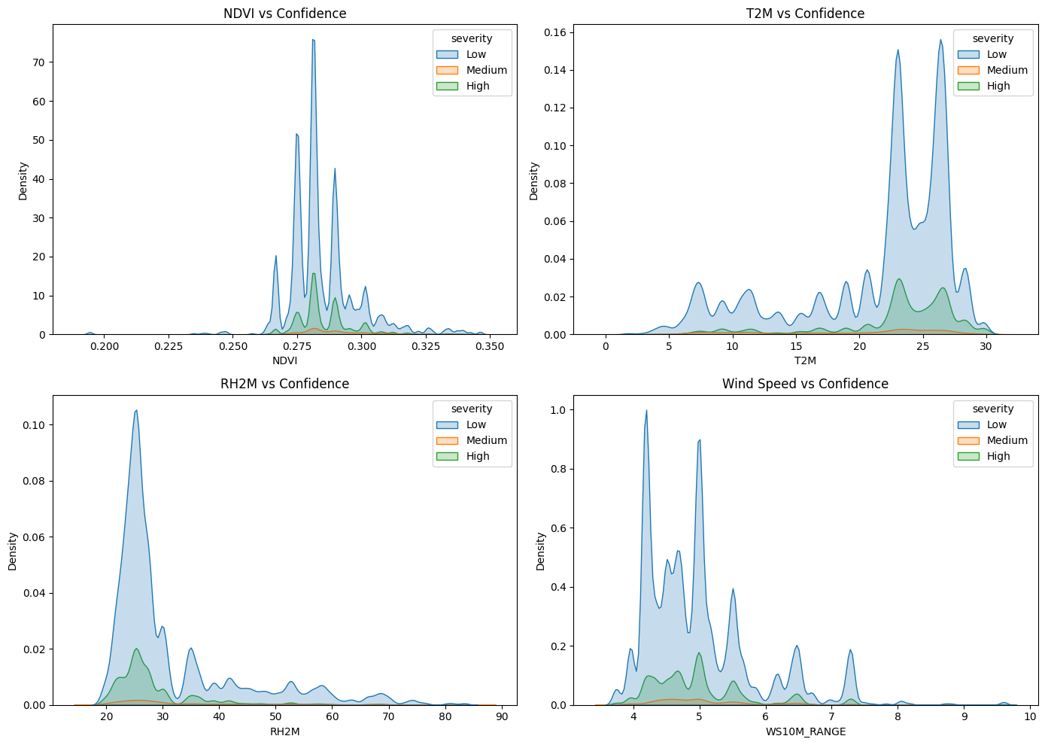
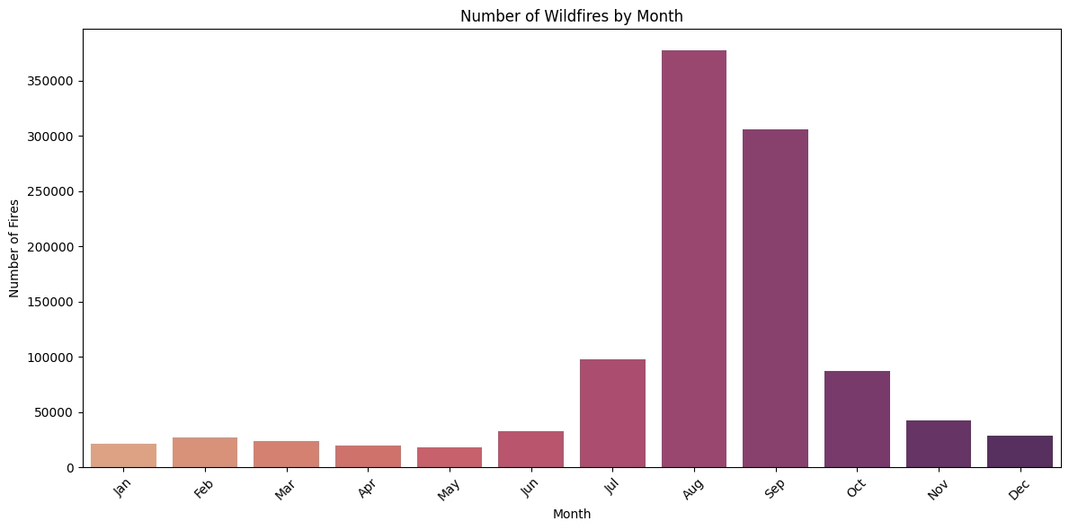
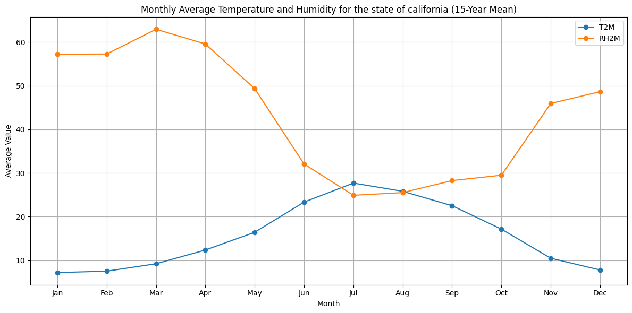
Exploratory Data Analysis
Climatic factors and monthly trends
Most wildfires recorded in areas with:
Vegetation Index: 0.27 – 0.30
Higher temperatures
Lower humidity
Low wind speed variation
Peak wildfire months: July – October
Low vegetation index: August – October
Low humidity levels: July – October
High temperatures: June – September

Slide 7

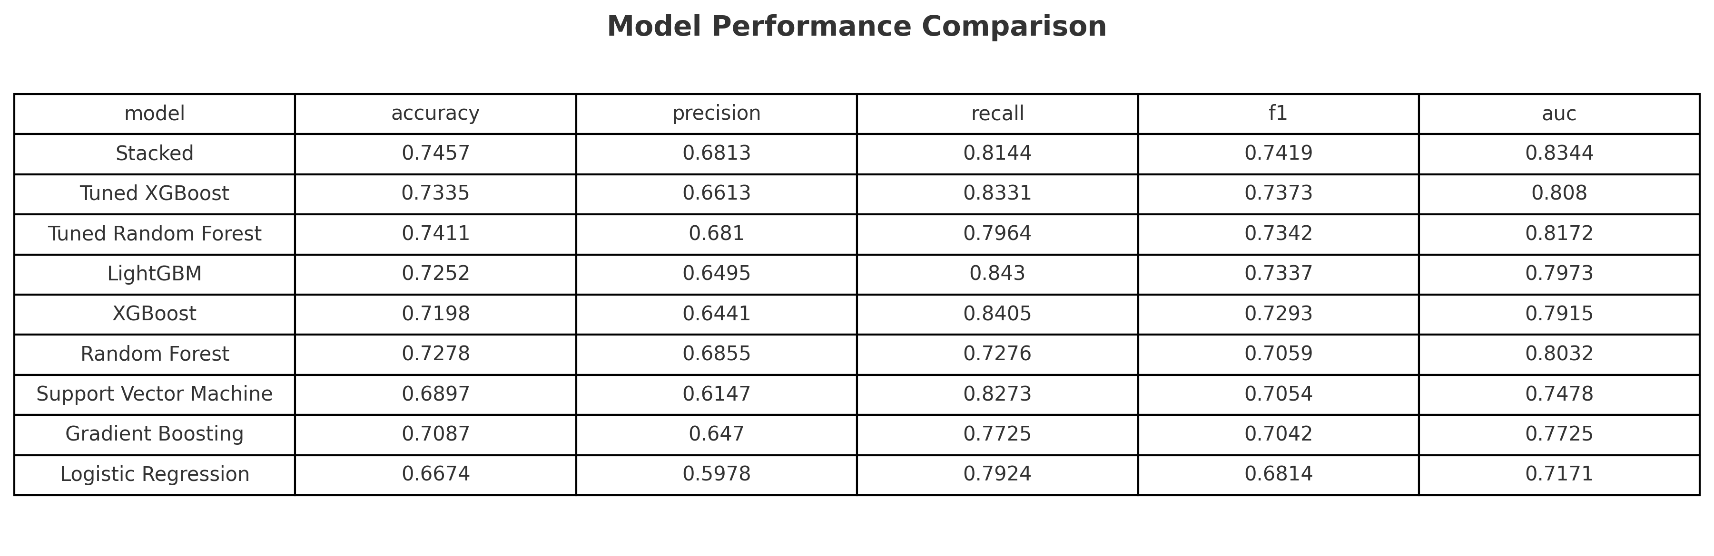
Data Modeling
Stacked model achieved the best F1 score by combining strengths of all XGBoost and RF models for balanced prediction
Stacked ensemble model
Tuned XGBoost
Tuned Random Forest
Most accurate and balanced model for wildfire prediction
Effectively captures complex fire patterns by combining multiple models
High recall (81%) means it reliably flags high-risk zones before fires occur
Handles environmental noise (e.g., sudden changes in temperature, wind) well
High AUC (0.817) shows it’s great at distinguishing risky from safe zones
XGBoost captures subtle patterns by optimizing depth and learning rate
Performs well on imbalanced data, where fires are rare but impactful
Detects fires with high recall (83%), ideal for early warning systems
Tuning enabled Random Forest model in capturing patterns across varying environmental conditions.

Slide 8
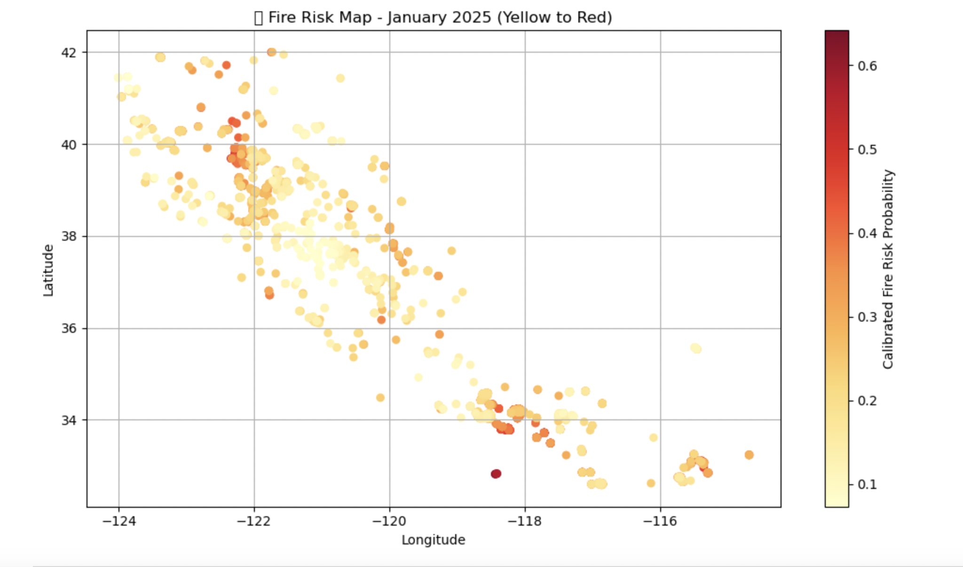
Results
Environmental drivers such as temperature (T2M), NDVI, and precipitation (PRECTOTCORR) were consistently ranked as the most influential factors in wildfire prediction
Top fire-prone regions predicted with probabilities ranging from 0.58 to 0.71, Average risk in flagged zones: ~62.4%
Applied feature scaling and engineered cyclic features (month_sin, month_cos), resulting in a ~2% gain in F1 score by improving seasonality capture in wildfire patterns
Fire hotspots accurately aligned with historical burn records in regions like Sierra Nevada and Los Padres

